Slide 1
Office of Research and Development (ORD)
Wendy Tenhula
Deputy Chief Research and Development Officer
VHA Office of of Research and Development (ORD/14RD)
March 13, 2023

Slide 2
Research is one of VA’s Four Statutory Missions
Develop, maintain, and operate a national health care delivery system for eligible Veterans
Support research to benefit veterans and the larger society
Provide education for health care trainees
Contingency support during times of war or national emergency
For more than 95 years, VA Research has been improving the lives of Veterans and all Americans through health care discovery and innovation
VA Research is part of the nation’s largest integrated health care system
VA Research collaborates with university affiliates, other federal agencies, nonprofit organizations, and private industry
Notes:
VA carries out four specific health-related missions: health care, education, research and emergency response.
Within VA, good support and recognition of importance of research as part of our healthcare system as a learning organization and as a high reliability organization
In VA’s new strategic plan for 2022-2028 – the word research appears 280x

Slide 3
VA Research Mission
To improve Veterans’ health and well-being via basic, translational, clinical, health services, and rehabilitation research. Apply scientific knowledge to develop effective individualized care solutions for Veterans
To attract, train, and retain the highest-caliber investigators, and nurture their development as leaders in their fields
To assure a culture of professionalism, collaboration, accountability, and the highest regard for research volunteers’ safety and privacy
Notes:
VA research by statute and design is designed to improve care for Veterans – AND it also has a big impact on all Americans
(e.g., huge VA study was the first to confirm that treating high blood pressure saved lives (fewer strokes; fewer people who need dialysis; fewer heart attacks;
to this day men with suspected of having prostate cancer get a blood test developed by a VA pathologist;
as noted this week study done with VA showed that when people at risk of suicide have a plan for how they will pause when actively contemplating suicide the rate of completed suicides is decreased by 45%)

Slide 5
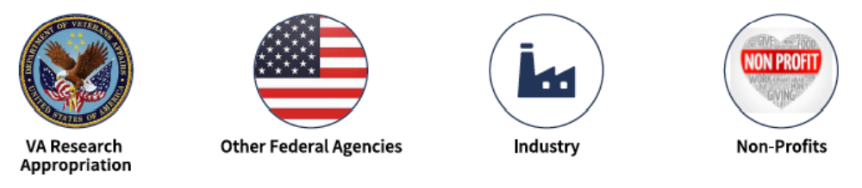
VA Research is Funded by Different Sources
VA ORD manages congressional research appropriations and distributes funds to research studies at VA hospitals across the country

Slide 6
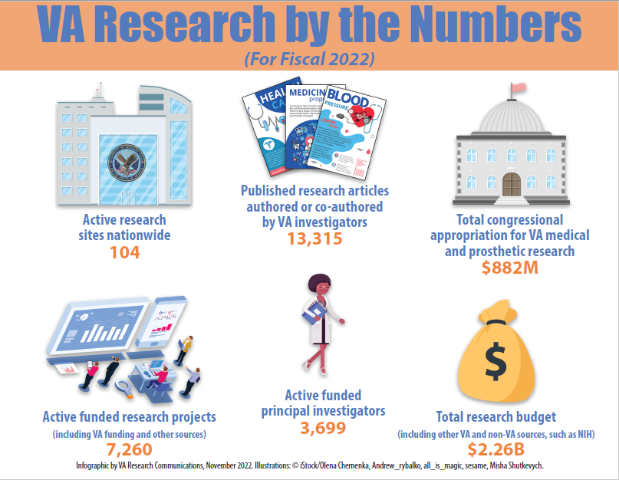
Notes:
For more than 95 years, the Veterans Affairs (VA) Research and Development program has been improving the lives of Veterans and all Americans through health care discovery and innovation. VA Research is unique because of its focus on health issues that affect Veterans. It is part of an integrated health care system with a state-of-the-art electronic health record and has come to be viewed as a model for superior bench-to-bedside research.
Today, VA Research has five overarching strategic priorities: increasing Veterans' access to high-quality clinical trials; increasing the real-world impact of VA research; putting VA data to work for Veterans; actively promoting diversity, equity, and inclusion; and building community through VA research.

Slide 7
How Does VA Set Research Priorities?
Prevalence, burden , and costs of conditions in Veterans
Regular communications with stakeholders (e.g. Veteran Service Organizations, etc.)
Congressional direction (e.g., Gulf War Illness, PTSD Service Dog Study)
VA leadership priorities
High Reliability Organization, Learning Healthcare System, Electronic Health Record Modernization
Suicide Prevention, Homelessness, Women Veterans, etc.
Joint Reviews With Federal Partners
National Research Action Plan for Psychological Health and Traumatic Brain Injury
Joint Reviews with Department of Defense and National Institutes of Health in key areas
State of the Art Conferences (e.g. Whole Health, Telehealth, Non-opioid Therapy for Chronic Pain)
Researchers embedded in VHA health system
Where is VA’s Unique Added Value?

Slide 8





ORD Strategic Priorities
 | Increase Veterans’ access to high quality clinical trials
 | Increase the substantial real-world impact of VA research
 | Put VA data to work for Veterans
 | Actively promote diversity, equity, and inclusion within our sphere of influence
 | Build community through VA research
For more information, visit: VA Strategic Priorities

Slide 9







Cross-Cutting Clinical Priorities
Military Environmental Exposures / Toxic Exposures
Posttraumatic Stress Disorder
Suicide Prevention
Traumatic Brain Injury
Precision Oncology
Pain and Opioid Use
COVID-19

Slide 10



























Journey of a Successful VA-funded Research Project
#1
RESEARCHER SUBMITS PROPOSAL
#4
#7
FUNDS SENT TO MEDICAL CENTER
CONDUCT RESEARCH OVER SEVERAL YEARS
#8
#3
ANALYZE DATA
#6
APPROVAL OF LOCAL R&D COMMITTEE
INITIATE RESEARCH
#5
HIRE RESEARCH STAFF AT MEDICAL CENTER
#9
#2
PUBLICATION AND APPLICATION (REAL-WORLD OUTCOMES)
FAVORABLE PEER REVIEW
4,600 research funded FTEs
12,000+ WOC/IPAs
2,000 proposals per year
550 new projects funded per year

Slide 11
Transforming into a Research Enterprise to Increase VA Research Real-World Impact
VA Research
VAMCs conducting research
~100 VA medical centers (VAMCs) independently conducting research
Office of Research & Development’s primary roles are funding and policy
Integrated whole in which we work as an enterprise
11

Slide 12



VA Research Enterprise Vision
The VA Research Enterprise is the entire research workforce cooperating to advance Veteran wellbeing. The VA Research Enterprise aspires to embody the following qualities:
Unique Value Proposition: Leverage our position as the only Federal research entity devoted to Veterans’ interests and being embedded in the nation’s largest integrated healthcare system
Operational Excellence: Operates with streamlined processes, effective collaboration, high-quality customer service, and appropriate resources
Engaged People: Composed of a vibrant, diverse research community united in our mission to improve Veterans’ well-being through research
Integration: Cultivate relationships and partnerships that accelerate our ability to achieve our mission
Real-world Outcomes: Define our success in terms of tangible real-world improvements in Veterans’ health and well-being
12

Slide 13
Recent HUD (2022) findings on Veteran homelessness
Between October 1, 2019, and September 30, 2020, almost 85,000 veterans experienced sheltered homelessness, one in every 160 veterans in the United States.
Nearly all veterans experiencing sheltered homelessness were in adult-only households rather than in families with children (97%).
Sheltered veterans were younger than all veterans in the United States. While nearly 60 percent of U.S. veterans in adult-only households were age 65 and older, only 18 percent of sheltered veterans were in that age group. A quarter of sheltered veterans were under the age of 45 in 2020, compared with 11 percent of all veterans.
Veterans who identified as Black or African American comprised more than a third of veteran heads of households experiencing sheltered homelessness (34%). This is three times the share of all U.S. veteran heads of adult-only households (12%).
Native American/American Indian and Alaska Native veterans in adult-only households were considerably overrepresented among the sheltered veteran population (4%) compared to their shares of the total veteran population in adult-only households and veterans in poverty (1%).
Seven of every 10 sheltered veterans (71%) reported a disability in 2020 and 22 percent had a chronic pattern of homelessness.
U.S. Department of Housing and Urban Development’s (HUD) 2019/2020 Annual Homeless Assessment Report (AHAR) Part 2.
Notes:
HUD - Has been homeless and living as described for at least 12 months* or on at least 4 separate occasions in the last 3 years, as long as the combined occasions equal at least 12 months and each break in homelessness separating the occasions included at least 7 consecutive nights of not living as described.

Slide 14

Funded studies of Veteran homelessness
ORD now provides more than
$4 million in annual support for research on Veteran homelessness
 | FY09 | FY14 | FY22
Number of studies | 1 | 14 | 18
Funds committed | $257,600 | $2,460,000 | $4,161,652
Centers | 0 | 2 | 3
Number of funded CDAs with homelessness as primary focus | 0 | 2 | 3
Notes:
Pleased to see that Homeless-experienced Veterans are once again a priority for VA. When I started in 2010, it was made a high priority – see that at the time there was only 1 ORD project! The work started with a 4 project joint initiative with HSR&D funding. The increase in fy14 reflects the increased attention to the issue. This attention seemed to drop a bit as attention increased for suicide prevention, but as you see, the investment of the investigators and ORD has continued to increase.

Slide 15
What we are investigating in ongoing studies on homelessness
Primary Care Quality and Homeless Service Tailoring. Stefan Kertesz, Birmingham, AL
Capturing the Dynamics of Homelessness through Ethnography and Mobile Technology. Donald McInnes, Bedford, MA
Measuring the impact of the Supportive Services for Veteran Families (SSVF) on Veteran outcomes. Richard Nelson, Salt Lake City, UT
Implementing and sustaining Critical Time Intervention (CTI) in case management programs for homeless-experienced Veterans. Sonya Gabrielian, West Los Angeles, CA
Using Data Analytics and Targeted Whole Health Coaching to Reduce Frequent Utilization of Acute Care among Homeless Veterans. Daniel Blonigen, Palo Alto, CA
The Enduring Effects of COVID-19 Infection on Psychological Factors, Cognition, and Social Integration in Recently Homeless Veterans. Jonathan Wynn, West Los Angeles, CA
Medical-legal partnerships to prevent evictions and homelessness among Veterans. Marc Rosen, West Haven, CT
Adapting and Pilot Testing a Group Intervention to Promote Adaptive Decision Making in Homeless-Experienced Veterans with Serious Mental Illness. Jared Greenberg, West Los Angeles, CA
Notes:
The Center conducts and supports research; assesses the effectiveness of programs; identifies and disseminates best practices and integrates these practices into polices, programs, and services for homeless or at-risk Veterans; and serves as a resource center for all research and training activities carried out by the Department and by other Federal and non-Federal entities with respect to Veteran homelessness. Developed a national cadre of affiliated investigators, many of whom seek and receive ORD research funds.
Determine the outcomes of Veterans contacting the Homeless Call Center and how to improve homeless prevention efforts
Compare characteristics of sheltered and unsheltered homeless veterans.
Longitudinal examination of VA homeless service users, their characteristics, and service use compared to other VA service users
study predicting positive and negative exits in HUD-VASH case management.
Use DOD data to identify Veterans at-risk of homelessness
Examine changes in healthcare delivery during COVID
Identify and define returns to homelessness
Identify major causes of mortality among justice-involved Veterans
Examine the use of battlefield acupuncture among homeless Veterans in Bedford
Analysis of suicide risk among homeless Veterans

Slide 16
Disparities Research In VA
VA is a good laboratory for studying disparities because it removes dominant role of coverage and access
33% of all VA users are from underserved populations; 43% of women users are from underserved populations
Interest in other sources of disparities including rurality, disability, gender and sexual orientation
National system with 171 medical centers and 1,113 outpatient sites allows us to examine variations by facilities, populations served, regional differences
Annual surveys of satisfaction, robust set of performance measures

Slide 17
Disparities Research In VA
Nearly 500 studies conducted of health disparities in VA
Patient:
Preferences/attitudes/beliefs/behaviors, trust, decision-making, health-literacy, and perceived discrimination
Provider:
Patient-provider communication, implicit bias, cultural competency
Decision making
System:
Access, patient-centered care
Community/Environment:
Social determinants of health

Slide 18
Update on Prevalence of and Interventions to Reduce Racial and Ethnic Disparities in VA (2017)
Studies examining the prevalence of disparities in Veterans of color were the most highly represented, followed by studies examining disparities in women, and in Veterans with a mental health condition
Very few studies examined disparities related to LGBT identity or homelessness, and only a limited number of studies examined the impact of socioeconomic status on utilization, health, or quality of care
Disparities findings varied widely by population and outcome

Slide 19
Research Solicitation on Social Determinants of Health
Was released in 2021
Wanted to expand focus beyond medical needs and medical services as cause or solution of disparities
Encouraged studies that would:
Increase recognition of SDOH in clinical setting
Improve understanding of how SDOH contributes to adverse health outcomes
Increase services to address SDOH
Examine variation in provision and utilization of services to address SDOH
Encourage novel VA-community partnerships to address SDOH

Slide 20
Areas of Recent Interest
COVID
No association between Black race and mortality and readmission; however, Black patients were less likely to receive COVID-19 treatments
Neither race nor ethnicity impact the mortality of residents of VA community living centers with COVID-19
Black Veterans with chronic pain expressed dissatisfaction with VA telehealth options during the pandemic.
Screening and Treatment of Pain
Screening comparable but Black patients less likely to get prescribed opiates
Implementation of Patient Medical Home
Somewhat slower in facilities with higher minority pop
Did not narrow disparities in chronic disease care
Treatment of mental health (PTSD, depression)
Lower use of psychotherapy, less likely to complete treatment

Slide 21


Questions and Discussion
Contact Information: Wendy.Tenhula@va.gov

